Slide 1
Unit 202: Principles of electrical science
a.c. generation

Slide 2
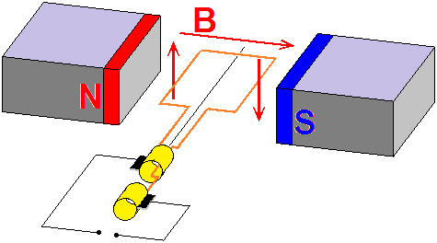
a.c. generation

Slide 3
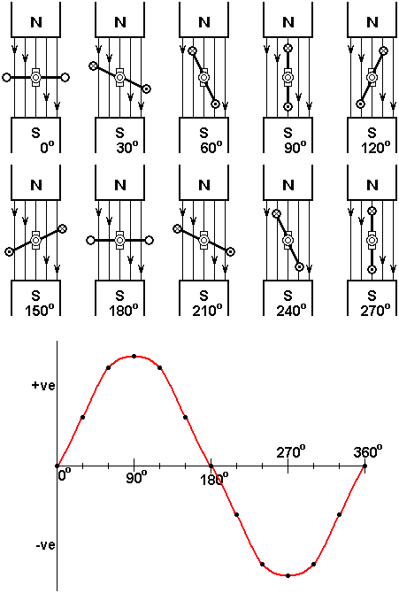
a.c. generation

Slide 4
a.c. generation
f | = | N.P
where: | f | = | Frequency (Hz)
 | N | = | Speed in revolutions per second
 | P | = | Number of pairs of poles
 |  |  | (a North and South are one pair)

Slide 5
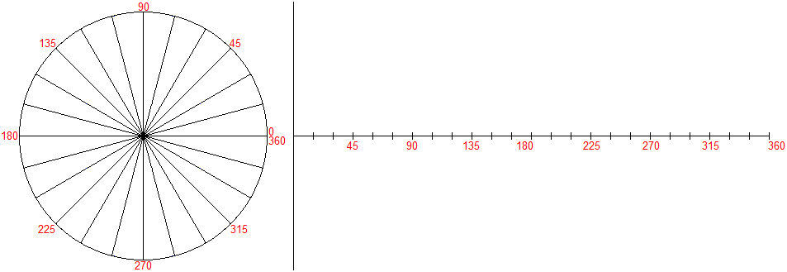
a.c. generation

Slide 6
a.c. generation

Slide 7
a.c. generation

Slide 8
a.c. generation

Slide 9
a.c. generation

Slide 10
a.c. generation

Slide 11
a.c. generation

Slide 12
a.c. generation

Slide 13
a.c. generation

Slide 14
a.c. generation

Slide 15
a.c. generation

Slide 16
a.c. generation

Slide 17
a.c. generation

Slide 18
a.c. generation

Slide 19
a.c. generation

Slide 20
a.c. generation

Slide 21
a.c. generation

Slide 22
a.c. generation

Slide 23
a.c. generation

Slide 24
a.c. generation

Slide 25
a.c. generation

Slide 26
a.c. generation

Slide 27
a.c. generation

Slide 28
a.c. generation

Slide 29
a.c. generation

Slide 30
a.c. generation

Slide 31
Unit 202: Principles of electrical science
The End

